Slide 1


UNIVERSITY INSTITUTE OF ENGINEERING
Academic Unit V
Bachelor of Engineering
(Computer Science & Engineering)
Biology For Engineers
(23SZT-148)
Biology for Engineers
DISCOVER . LEARN . EMPOWER

Slide 2
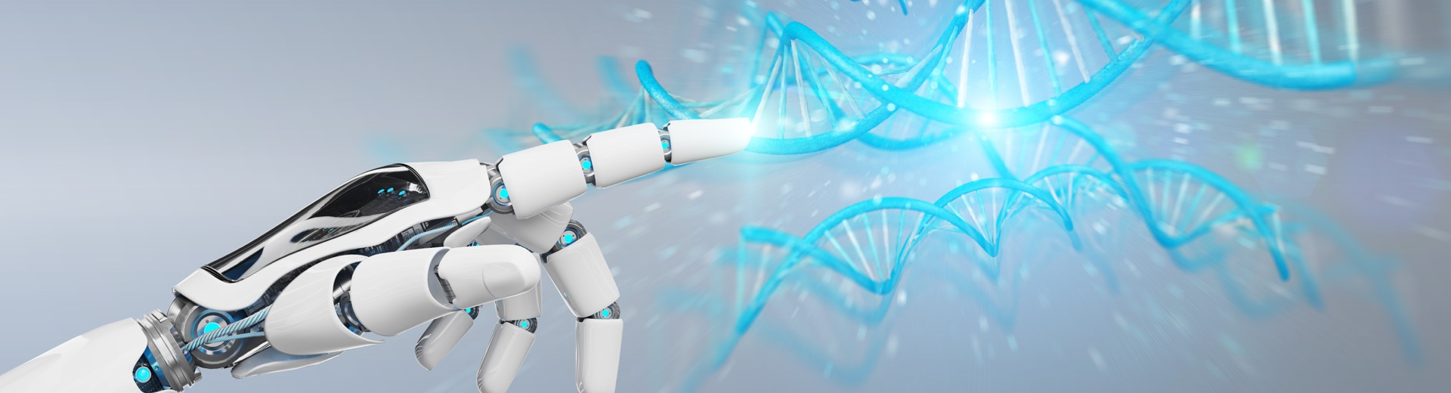
INTRODUCTION
Course Objective
This subject is designed to impart fundamental knowledge on basic of genetics and emerging fields of biology like biomedical recording system and medical instrumentation.
It is designed to impart knowledge that how to apply basics of biology in engineering.
https://www.uic.es/sites/default/files/uic-grau-bioenginyeria-hero-header_1.jpg
Biology for Engineers

Slide 3

INTRODUCTION
Course Outcome
Space for visual (size 24)
CO Number | Title | Level
CO1 | Identify the biological concepts from an engineering perspective. | knowledge
CO2 | Development of artificial systems mimicking human action. | Understand
CO3 | Explain the basic of genetics that helps to identify and formulate problems | Analyze
CO4 | Apply knowledge of measurement system, biomedical recording system and biosensors to excel in areas such as entrepreneurship, medicine, government, and education. | Apply
CO5 | Integrate biological principles for developing next generation technologies, | Create
Will be covered in this lecture
https://specials-images.forbesimg.com/imageserve/1034901762/960x0.jpg?fit=scale
Biology for Engineers

Slide 4

Unit-1 | Importance of Biology In Engineering | Contact Hours: 15
Chapter 1 Significance of Biology in Engineering Chapter 2 Genetics | Introduction: Fundamental Differences between Science and engineering by drawing a comparison between eye and camera, Bird flying and aircraft. Significance of Biology in Engineering, Discuss how biological observations of 18th Century that lead to major discoveries, Examples from Brownian motion and the origin of thermodynamics by referring to the original observation of Robert and Julius Mayor. Genetics: Mendel’s laws, Concept of segregation and independent assortment, concept of allele, gene mapping, Gene interaction, Epitasis, Meiosis and Mitosis as a part of genetics. Mechanism of how genetic material passes from parent to offspring. Concepts of recessiveness and dominance. Concept of mapping of phenotype to Genes, single gene disorders in humans, concept of complementation using human genetics.
Biology for Engineers

Slide 5

Mendel’s Laws of Inheritance

Slide 6

What is genetics?
  “Genetics is the study of heredity, the process in which a parent passes certain genes onto their children.”
What does that mean?
  Children inherit their biological parents’ genes that express specific traits, such as some physical characteristics, natural talents, and genetic disorders.
Biology for Engineers
Notes:
Conduct a brief class discussion to assess students’ knowledge and assumptions about genetics, while providing the information to those students who may not have any prior knowledge.

Slide 7

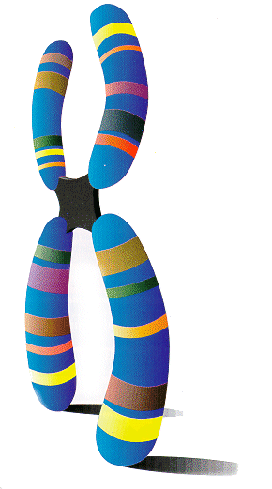
Heredity describes how some traits are passed from parents to their children.
The traits are expressed by genes, which are small sections of DNA that are coded for specific traits.
Genes are found on chromosomes.
  Humans have two sets of 23 chromosomes—one set from each parent.
Biology for Engineers
Notes:
Have students volunteer their answers, and help students understand that the inherited traits are passed from one generation to the next as the parents’ chromosomes are copied and passed to their children.

Slide 8
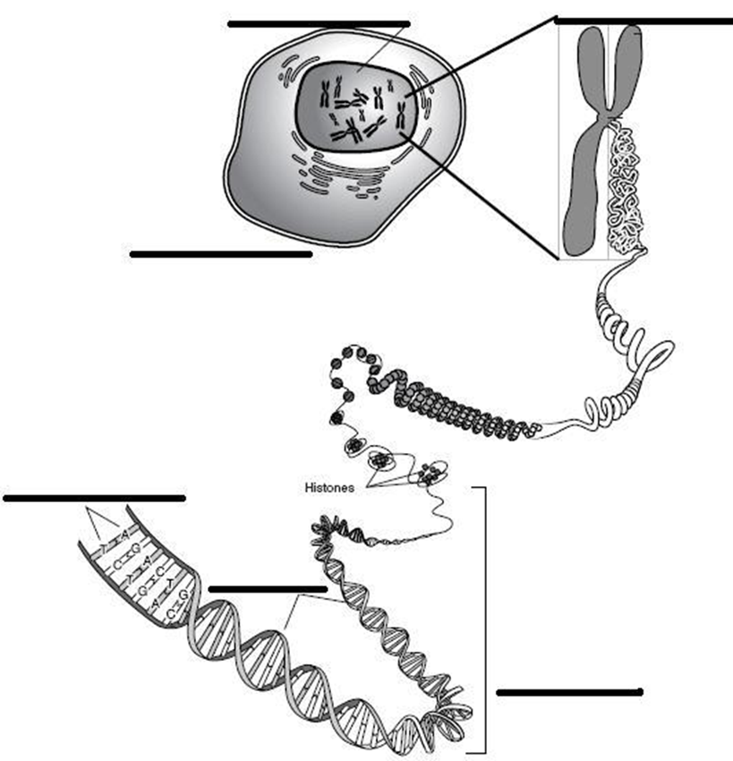
Nucleus
Chromosome
DNA is the “instruction code” that the genes use to form traits.
  DNA is long threads of material found in all cells.
  DNA contains the “master code” that instructs all cells in their daily jobs.
  Genes are short pieces of DNA that make up our chromosomes.
  Each piece of DNA that is related to a gene makes up one trait.
Cell
Nucleotides
Genes
DNA

Slide 9

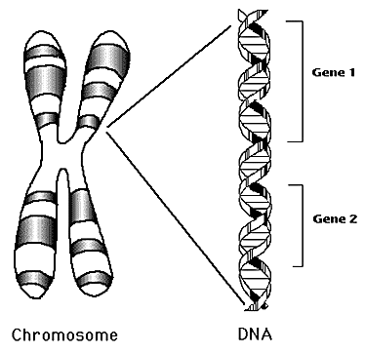
Genes influence the development of traits
  All of an organism’s genetic material is called the genome.
  A genotype refers to the makeup of a specific set of genes.
  A phenotype is the physical expression of a trait.

Slide 10
What is a Trait?
  A trait is a specific characteristic that is unique.
  Traits affect the way we look
  Traits affect how our bodies function
  Traits are inherited
    Examples are hair color, eye color, handedness, etc.

Slide 11
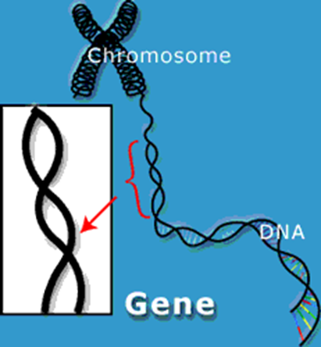
Gene – a unit of heredity; a section of the DNA sequence encoding a single protein
Genome – the entire set of genes in an organism
Alleles – two genes that occupy the same position on homologous chromosomes and that cover the same trait (like ‘flavors’ of a trait).
Locus – a fixed location on a strand of DNA where a gene or one of its alleles is located.
Biology for Engineers

Slide 12
Homozygous – having identical alleles of a gene (one from each parent) for a particular characteristic.
Heterozygous – having two different alleles of a gene for a particular characteristic.
Dominant – the allele of a gene that masks or suppresses the expression of an alternate allele; the trait appears in the heterozygous condition.
Recessive – an allele that is masked by a dominant allele; does not appear in the heterozygous condition, only in homozygous.
Genotype – the genetic makeup of an organisms
Phenotype – the physical appearance of an organism (Genotype + environment)
Biology for Engineers

Slide 13

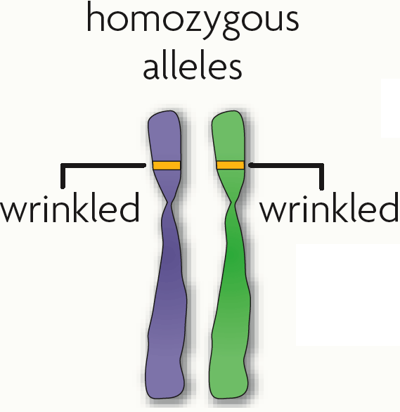
The same gene can have many versions:
  A gene is a piece of DNA that directs a cell to make a certain protein.
  Each gene has a locus, a specific position on a pair of homologous chromosomes.

Slide 14
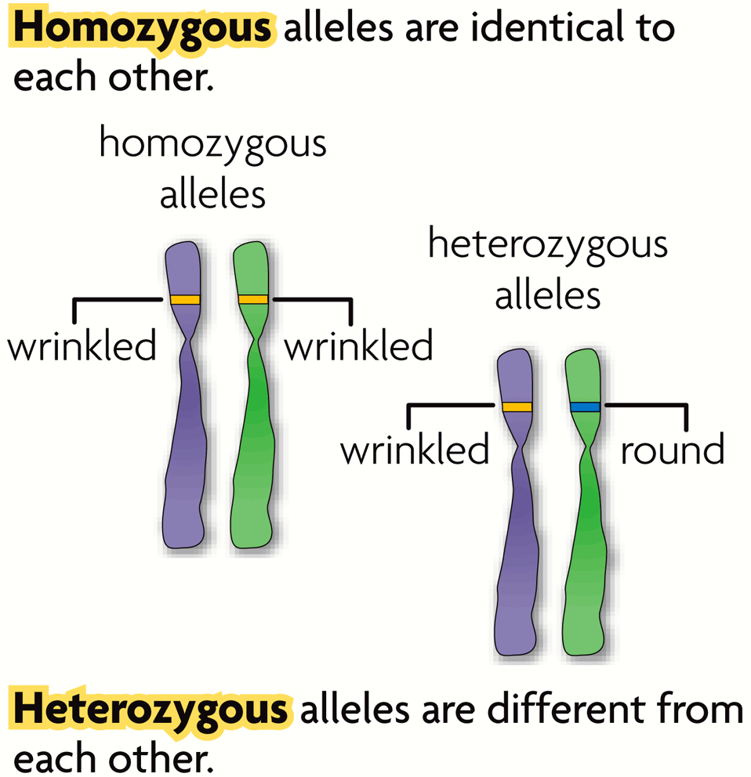
An allele is any alternative form of a gene occurring at a specific locus on a chromosome
  Each parent donates one allele for every gene.
  Homozygous describes two alleles that are the same at a specific locus.
  Heterozygous describes two alleles that are different at a specific locus.

Slide 15
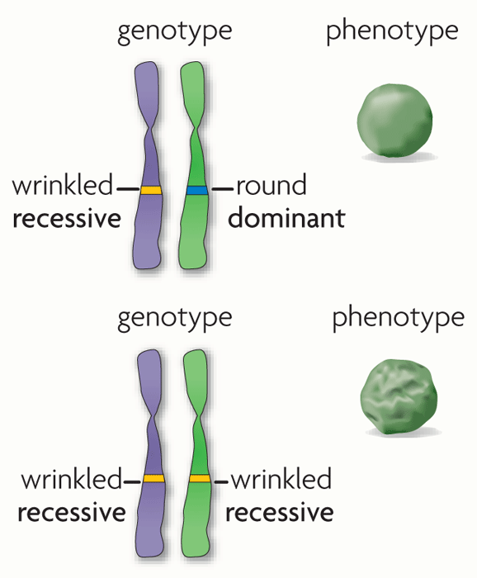
Alleles can be represented using letters
  A dominant allele is expressed as a phenotype when at least one allele is dominant.
  A recessive allele is expressed as a phenotype only when two copies are present.
  Dominant alleles are represented by uppercase letters; recessive alleles by lowercase letters.
  Both homozygous dominant and heterozygous genotypes yield a dominant phenotype.
  Most traits occur in a range and do not follow simple dominant-recessive patterns.
r
R
r
r

Slide 16

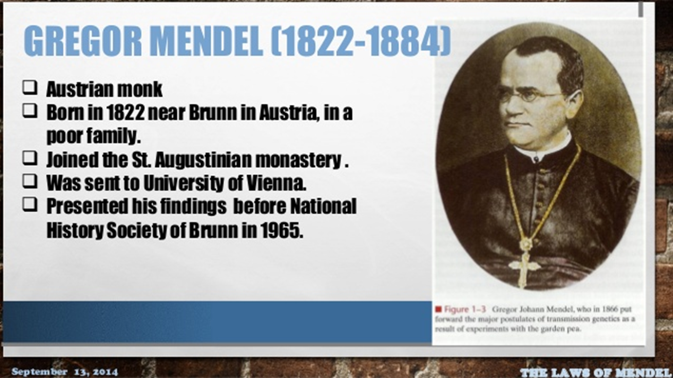
Genetics began with the work of Gregor Mendel.
Gregor developed basic principles of heredity without ANY scientific equipment and NO knowledge of genes or chromosomes - only his mind!
Gregor experimented with pea plants, by crossing various strains and observing the characteristics of their offspring.
Biology for Engineers

Slide 17
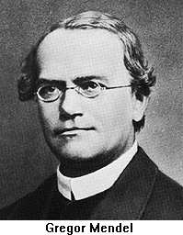
Austrian Monk, born in what is now Czech Republic in 1822
Son of peasant farmer, studied Theology and was ordained
priest Order St. Augustine.
Went to the university of Vienna, where he
studied botany and learned the Scientific Method
Worked with pure lines of peas for eight years
In 1865 he published Experiments in Plant Hybridization, (Versuche über Pflanzen-Hybriden) in which he established his three Principles of Inheritance
Work was largely ignored for 34 years, until 1900, when
3 independent botanists rediscovered Mendel’s work.
Prior to Mendel work, heredity was regarded as a "blending"
process and the offspring were essentially a "dilution“ of the different parental characteristics.
Biology for Engineers

Slide 18
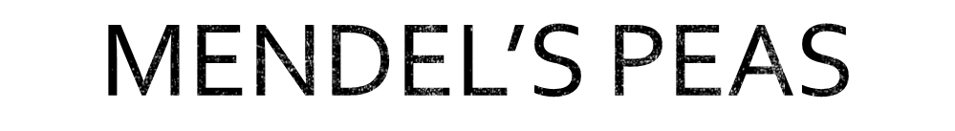
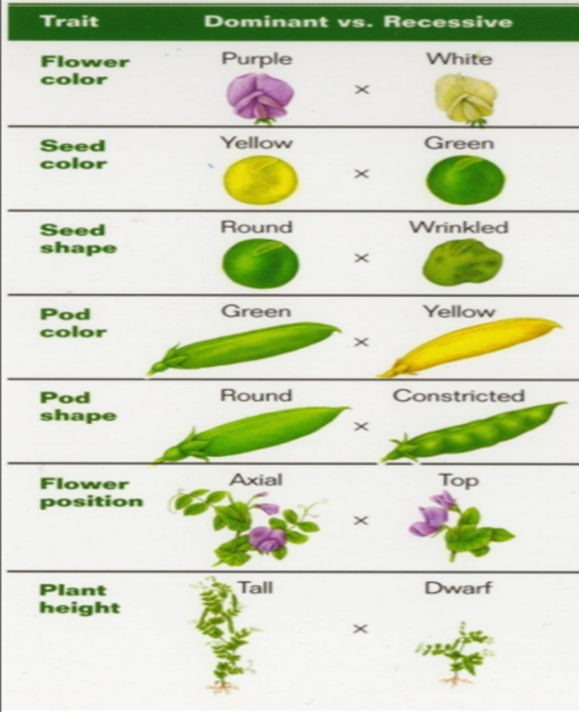
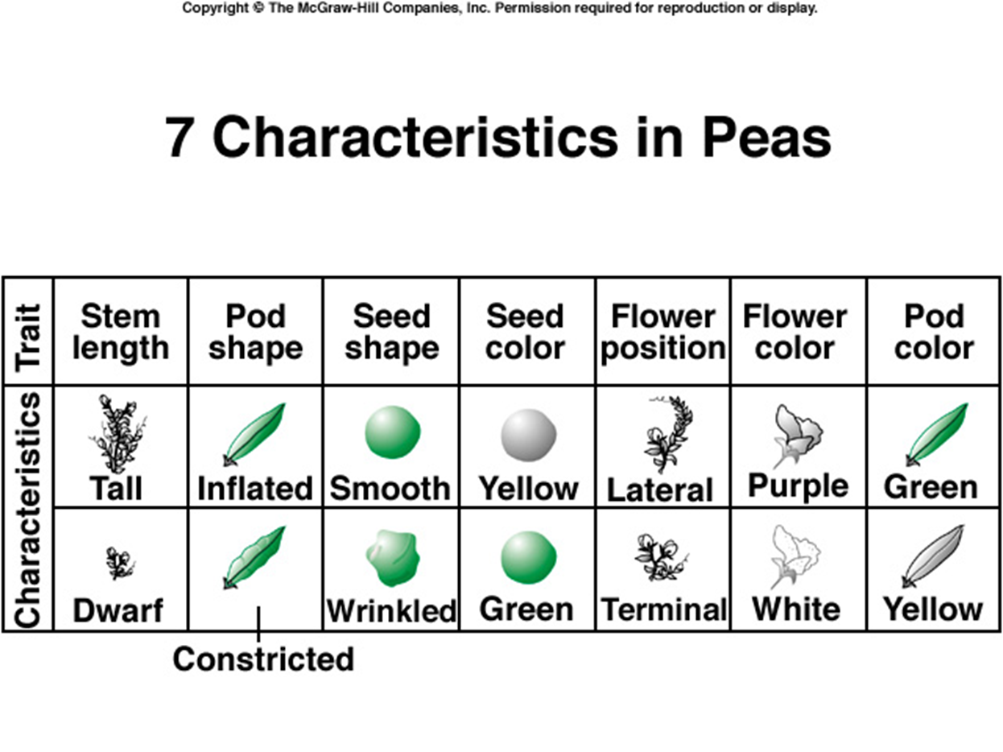
Mendel looked at seven traits or characteristics of pea plants:
Biology for Engineers

Slide 19

He selected the garden pea plant as a sample for the following reasons:
Pea is available in many varieties on a large scale to observe alternate traits.
Peas are self-pollinated and can be cross-pollinated also to prevent self-pollination.
These are annual plants with a short life cycle. So, several generations can be studied within a short period.
Pea plants could easily be raised, maintained and handled.

Slide 20
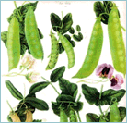
Mendel was the first biologist to use Mathematics – to explain his results quantitatively.
Mendel predicted
The concept of genes
That genes occur in pairs
That one gene of each pair is present in the gametes
Biology for Engineers

Slide 21

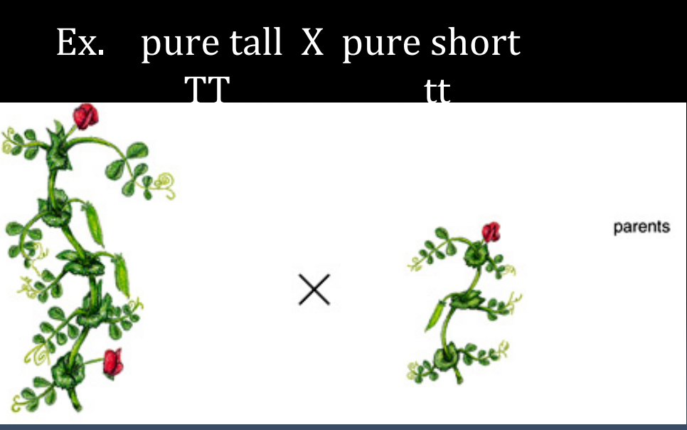
Mendel began by cross-pollinating pure plants with contrasting traits
Biology for Engineers

Slide 22
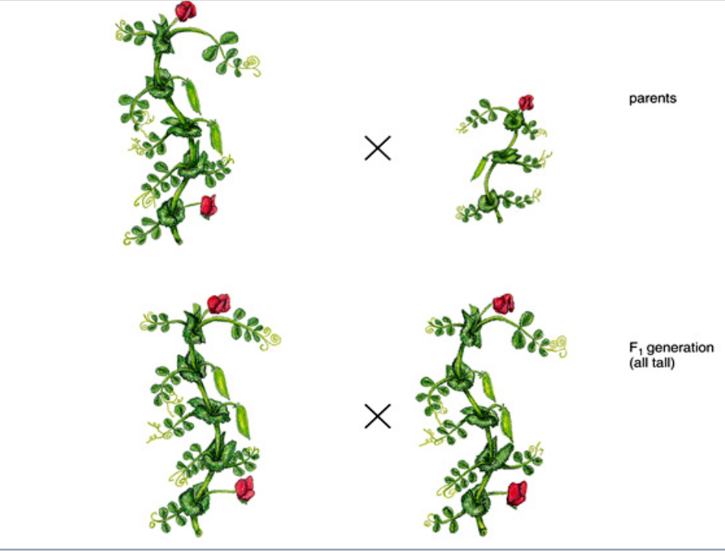
Mendel then observed the offspring or 1st Filial generation (F1), and noticed only one trait (they were all tall)
Biology for Engineers

Slide 23
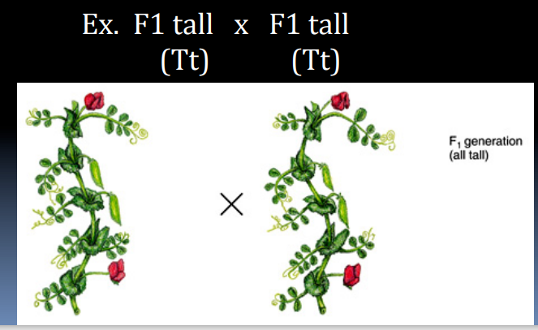
Mendel then used two of these F1 tall plants and crossed them.
Biology for Engineers

Slide 24
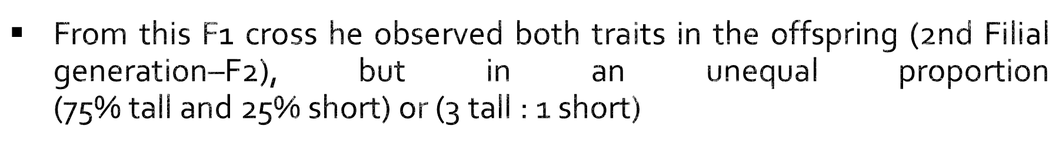
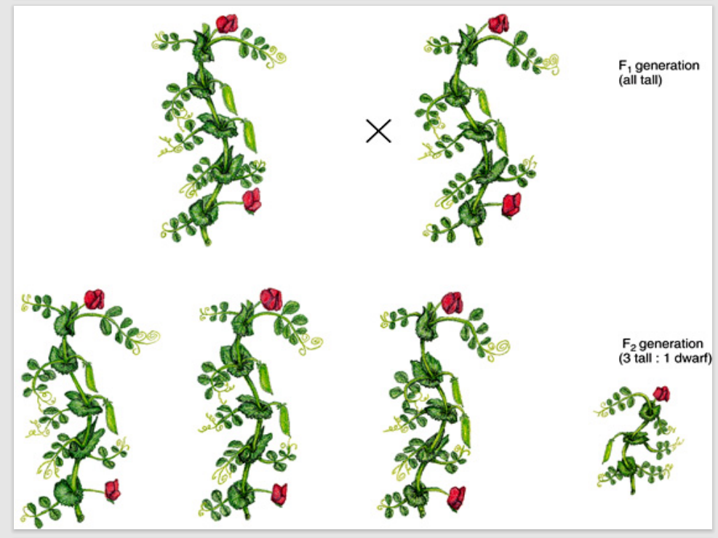
Biology for Engineers

Slide 25
Mendel determined that one form of the trait is dominant over the other recessive trait (Tall is dominant over short)
Parents | pure tall | X | pure short
F1 | all tall
F2 | 3 tall | : | 1 short
Biology for Engineers

Slide 26
According to this law
  Characters are controlled by discrete units called factors
  Factors occur in pairs
  In a dissimilar pair of factors (heterozygous) one member of the pair dominates the other
It is because of law of dominance only one parental character expresses itself in the F1 generation while both are expressed in F2 generation.
Biology for Engineers

Slide 27
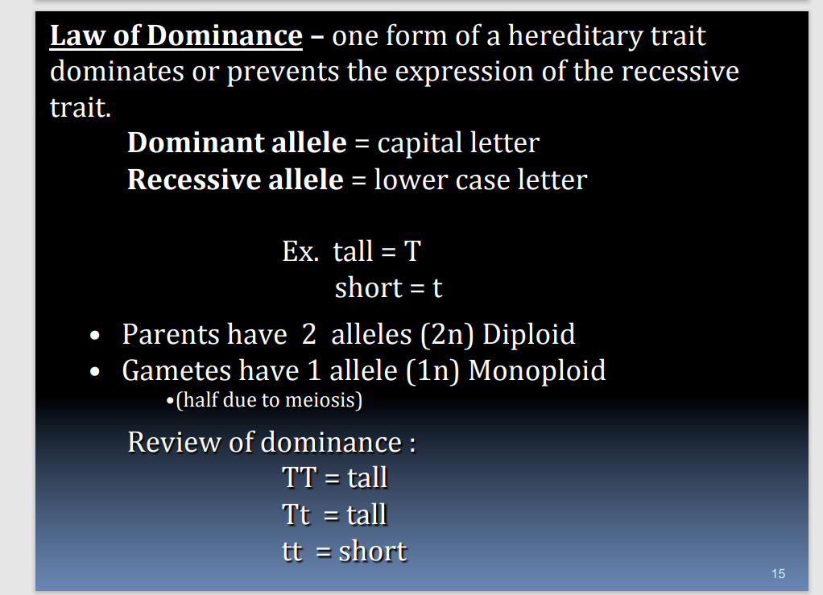
Biology for Engineers

Slide 28
According to this law parents contain two alleles during gamete formation, the factors or alleles of pair segregate from each other such that a gamete receives only one of the two factors.
A homozygous parent produces all gametes that are similar while a heterozygous one, produces two kinds of gametes each having one allele with equal proportion
Biology for Engineers

Slide 29
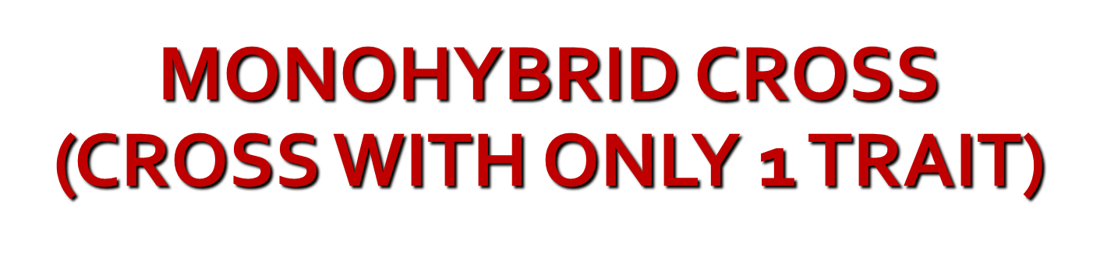
Problem
  Using this is a several step process, look at the following example
    Tallness (T) is dominant over shortness (t) in pea plants.
    A Homozygous tall plant (TT) is crossed with a short plant (tt).
    What is the genotypic makeup of the offspring? The phenotypic makeup?
Biology for Engineers

Slide 30
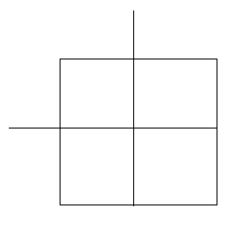
PUNNETT SQUARES
Genetic problems can be easily solved using a tool called a Punnett square.
  Tool for calculating genetic probabilities
A Punnett square
Biology for Engineers

Slide 31

Punnett Squares: The chart used to show the possible ways genes are combined when passed from parents to offspring.
Dominant genes are UPPER CASE (T)
Recessive genes are lower case (t)
Each parent has two genes for a trait. (TT), (Tt) or (tt).
There can be a possible four combinations for each cross.
Biology for Engineers

Slide 32

GENOTYPE: The gene combination
Homozygous– Pure dominate or pure recessive
Heterozygous– Hybrid a mixed
PHEOTYPE :The physical appearance
Dominate trait
Recessive trait
Combination of two traits (incomplete dominance)
Biology for Engineers

Slide 33
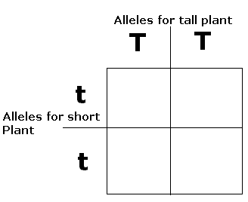
PUNNETT PROCESS
Determine alleles of each parent, these are given as TT, and tt respectively.
Take each possible allele of each parent, separate them, and place each allele either along the top, or along the side of the Punnett square.
Biology for Engineers

Slide 34
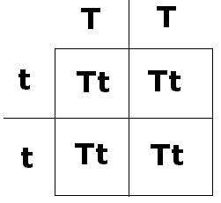
PUNNETT PROCESS CONTINUED
Lastly, write the letter for each allele across each column or down each row.
The resultant mix is the genotype for the offspring (F1 generation).
In this case, each offspring has a Tt (heterozygous tall) genotype, and simply a "Tall" phenotype.
F1 Generation
Biology for Engineers

Slide 35
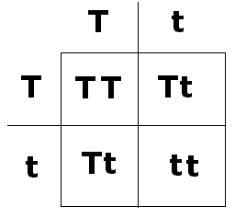
PUNNETT PROCESS
Here we have some more interesting results: First we now have 3 genotypes (TT, Tt, & tt) in a 1:2:1 genotypic ratio.
We now have 2 different phenotypes (Tall & short) in a 3:1 Phenotypic ratio.
This is the common outcome from such crosses.
F2 Generation
Biology for Engineers

Slide 36
This law states that when two pairs of traits are combined in a hybrid, segregation of one pair of characters is independent of the other pair of characters.
Mendel was interested in determining whether alleles at 2 different gene loci segregate dependently or independently
Crossing two, true-breeding parents differing in two characters produces dihybrids in the F1 generation, heterozygous for both characters
Biology for Engineers

Slide 37
DIHYBRID CROSSES
Dihybrid crosses are made when phenotypes and genotypes composed of 2 independent alleles are analyzed.
Process is very similar to monohybrid crosses.
Example:
  2 traits are being analyzed
  Plant height (Tt) with tall being dominant to short,
  Flower color (Ww) with Purple flowers being dominant to white.
Biology for Engineers

Slide 38
With his monohybrid crosses, Mendel determined that the 2 alleles at a single gene locus segregate when the gametes are formed.
With his dihybrid crosses, Mendel was interested in determining whether alleles at 2 different gene loci segregate dependently or independently.
For example, in pea plants seed shape is controlled by one gene locus where round (R) is dominant to wrinkled (r) while seed color is controlled by a different gene locus where yellow (Y) is dominant to green (y).
Mendel crossed 2 pure-breeding plants: one with round yellow seeds and the other with green wrinkled seeds.
Biology for Engineers

Slide 39
INDEPENDENT SEGREGATION
Alleles at the 2 gene loci segregate (separate) independently, and are NOT transmitted as a unit.
Therefore, each plant would produce gametes with allele combinations that were not present in the gametes inherited from its parents:
R R
Y Y
r r
y y
Parents
Parental Gametes
R
Y
r
y
F₁ Offspring
R r
Y y
F₁ Offspring’s Gametes
R
Y
R
y
r
Y
r
y
What is the expected phenotypic ratio for the F₂?
Biology for Engineers

Slide 40
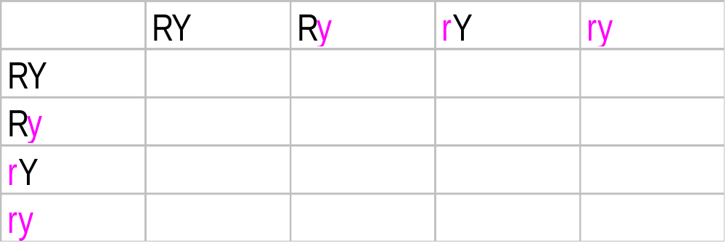
Dihybrid cross - parental generation differs in two traits
Example-- cross round/yellow peas with wrinkled/green ones
Round/yellow is dominant
What are the expected phenotype ratios in the F₂ generation?
round, yellow = round, green =
wrinkled, yellow = wrinkled, green =
Biology for Engineers

Slide 41
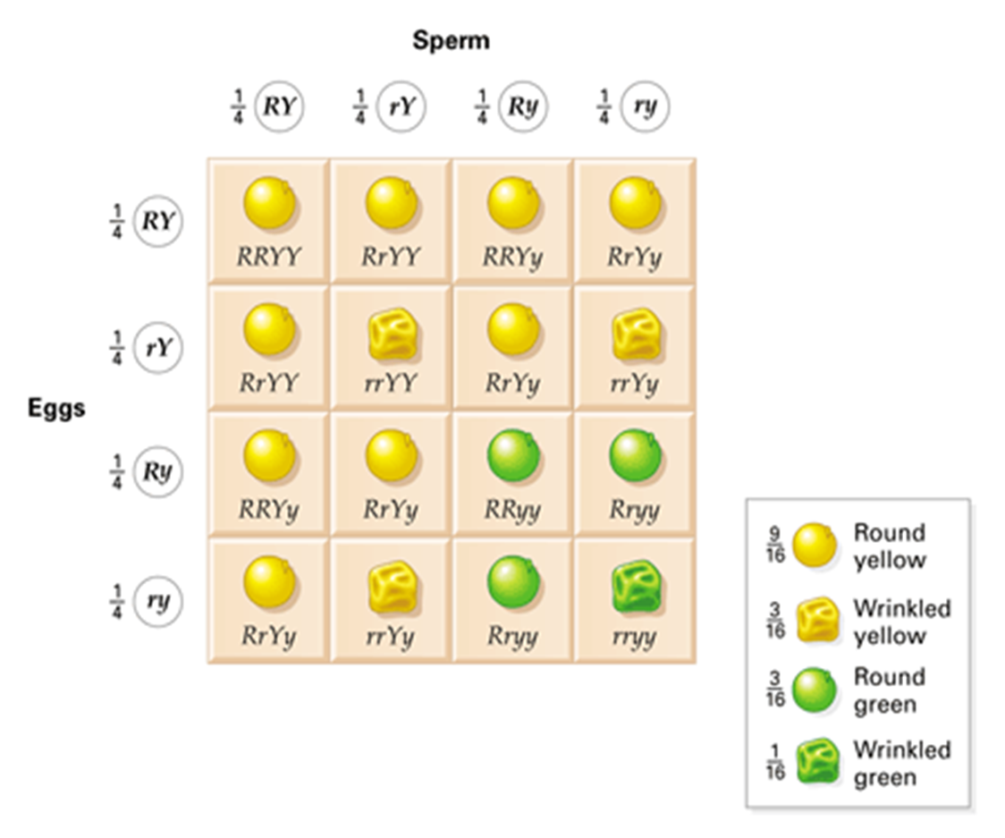
F₂ with Independent Assortment
RY
Ry
rY
ry
RR YY | RR Yy | Rr YY | Rr Yy
RR Yy | RR yy | Rr Yy | Rr yy
Rr YY | Rr Yy | rr YY | rr Yy
Rr Yy | Rr yy | rr Yy | rr yy
RY
Ry
rY
ry
Phenotypic ratio is 9 : 3 : 3 : 1
Biology for Engineers

Slide 42

Genes are distinct entities that remain unchanged during crosses
Each plant has two alleles of a gene
Alleles segregated into gametes in equal proportions, each gamete got only one allele
During gamete fusion, the number of alleles was restored to two
Biology for Engineers

Slide 43

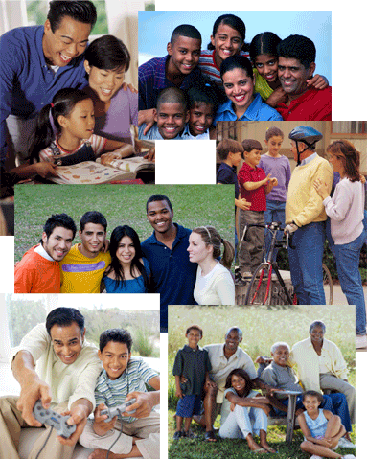
Have you ever been told that you resemble one parent more than the other?
The reason for this may be due to having received more dominate genes from the parent you resemble.
However, you receive half of all your chromosomes and genes from each parent.
Each parent passes to you 23 chromosomes for a total of 46 chromosomes.
Biology for Engineers

Slide 44

Gupta, P.K.. Cytology, Genetics and Molecular Biology, Rastogi Publishers, Meerut, 1993.
Roit I.M., Brostoff J. and Male D. Mosby .Immunology (6 th Edition) by, An imprint of Elsevier Sci Ltd., 2002.
https://www.youtube.com/watch?v=wv1TQXBQ6wQ
https://www.youtube.com/watch?v=zNEtVaNQ0s8
(http://www.nlm.nih.gov/medlineplus/ency/article/002048.htm)
https://nptel.ac.in/courses/121/106/121106008/
https://www.utoledo.edu/engineering/bioengineering/undergrad/prospective/whatisbioe.html#:~:text=Bioengineering%20is%20the%20application%20of,health%20care%20and%20other%20fields.
https://i.pinimg.com/originals/68/c9/30/68c930e95113ceb2e3dfc9de2f164680.png
https://youtu.be/FBUpnG1G4yQ
Biology for Engineers
<number>/10

Slide 45

THANK YOU
Biology for Engineers

